Slide 1
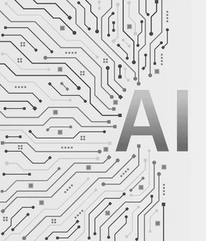
Artificial Intelligence Lab
Welcome to the Artificial Intelligence Lab course summary. This presentation highlights our journey through fundamental AI concepts and practical applications from January to June 2025.

Slide 2
Course Overview
Artificial Intelligence Lab: January - June 2025
Course Name: Artificial Intelligence Lab
This six-month lab course provided a comprehensive understanding of AI principles, techniques, and applications. Our primary focus was on bridging theoretical foundations with practical algorithm implementation and solution development.
Course Code: CSE-06133116
Instructor: Razorshi Prozzwal Talukder
Presented By:
Ahsan Habib Nayef

Slide 3
Purpose of the Course
Comprehensive Understanding
Theoretical Foundations
Practical Application
To apply theoretical knowledge by creating practical AI solutions, especially through game development.
To provide a deep dive into fundamental AI principles, techniques, and their real-world applications.
To build a strong grasp of the underlying theories behind various AI algorithms.

Slide 4




Core Concepts Explored
AI Fundamentals
Problem-Solving
Understanding the basic principles and diverse real-world applications of Artificial Intelligence.
Mastering various search algorithms for effective computational problem-solving.
Heuristic Approaches
Game Theory & Decision-Making
Employing heuristic strategies to tackle complex and computationally intensive problems efficiently.
Delving into game theory principles and algorithms for intelligent decision-making in competitive environments.

Slide 5
Algorithms and Implementations
1
Basic Search Algorithms
2
Advanced Search Techniques
In-depth study and implementation of Breadth-First Search (BFS), Depth-First Search (DFS), Best-First Search, and A* search.
Exploration and coding of Bidirectional Search, Depth-Limited Search (DLS), and Iterative Deepening Search (IDS).
3
Game-Playing Algorithms
4
Optimization Techniques
Practical implementation of Minimax and Alpha-Beta Pruning for optimal decision-making in games.
Hands-on experience with Hill Climbing and Beam Search for local and global optimization problems.

Slide 6
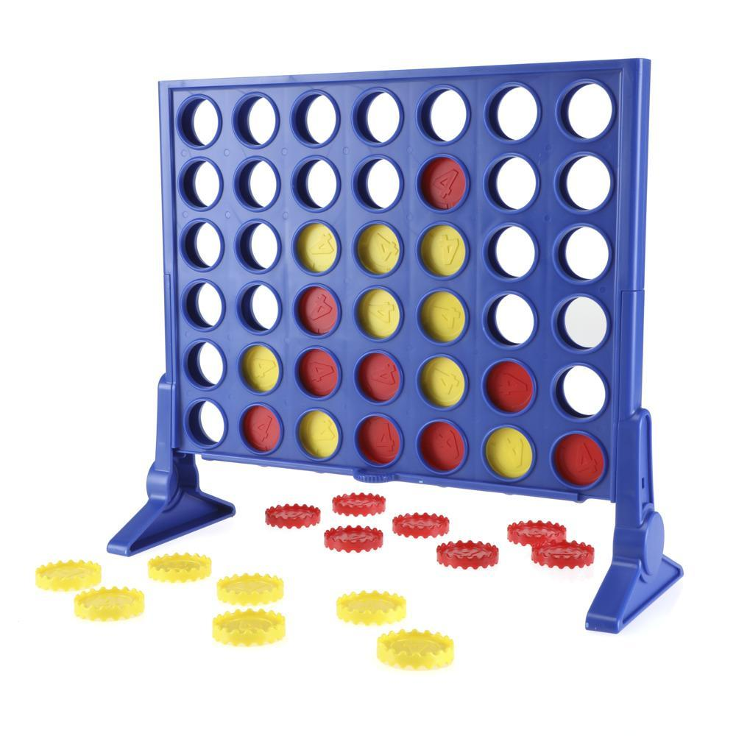
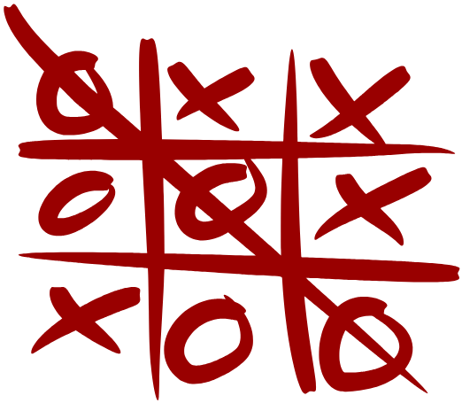

Project Highlights: AI Games
A central component of our lab work involved developing AI opponents for classic games, demonstrating mastery of decision-making algorithms:
Tic-Tac-Toe: Implemented an unbeatable AI using Minimax with full game tree exploration.
Connect Four: Developed an AI that evaluates board states to make strategic moves, often leveraging Minimax with depth limits.
Chess: Created a Chess AI utilizing Alpha-Beta Pruning to efficiently search vast game states, capable of playing against human opponents.

Slide 7
Project Highlights: Algorithm Implementation & AI Tools
Algorithm Implementation
AI Tools Exploration
Applied various search algorithms to solve complex pathfinding and constraint satisfaction problems.
Leveraged cutting-edge AI tools to enhance content creation and presentation skills:
Demonstrated game-playing algorithms in interactive simulations.
Video Creation: Produced a 1-minute video summarizing the AI course, integrating both theoretical concepts and practical lab work.
Explored optimization algorithms for efficiency in problem-solving.
Presentation Development: Designed a comprehensive 10-12 slide presentation on course topics and lab tasks, showcasing effective communication through AI-assisted design.

Slide 8




Skills Developed Throughout the Course
Algorithm Design & Analysis
Problem-Solving & Critical Thinking
Proficiency in designing, analyzing, and implementing efficient algorithms for AI problems.
Enhanced ability to break down complex problems and devise innovative AI-driven solutions.
Real-World Application
Ethical Understanding
Capability to translate theoretical AI concepts into practical, deployable systems.
A nuanced understanding of the ethical implications and inherent limitations of AI systems.

Slide 9
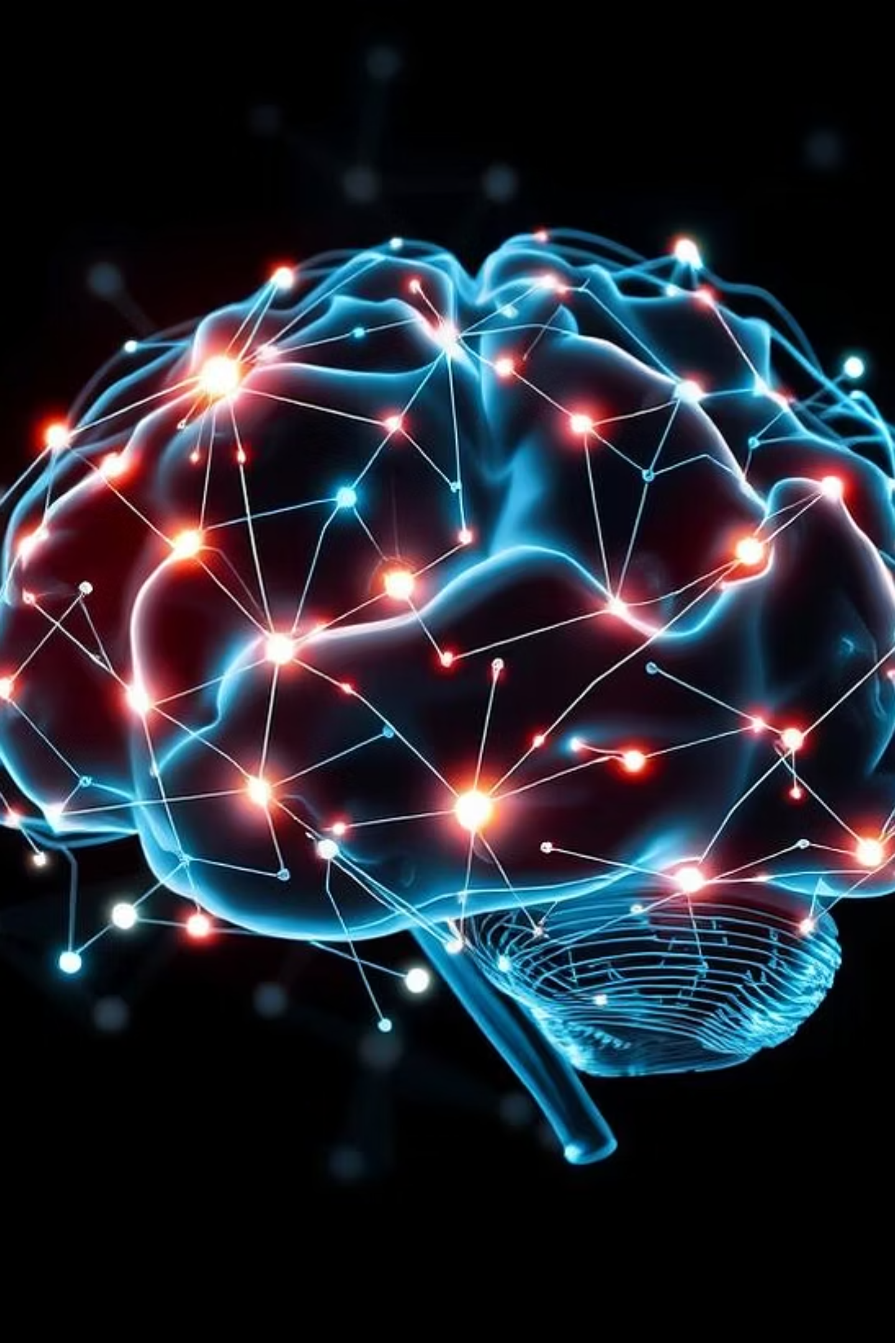
Thank You!
We appreciate your engagement and interest in the Artificial Intelligence Lab course. We hope this summary provided valuable insights into the exciting world of AI.

